Slide 1


Intel Industrial AI
Ciaran Dowds
Jacob Jenner
Ludwig Jonsson
Frederick McCallum
Nikita Swaroop
Supervisor: Dr John Wickerson
Solution Demonstration
Notes:
Jacob: Hey guys welcome to our TED talk.

Slide 2
Project Brief
Robotics and Machinery Require Efficient Movement
Achieve with Nonlinear Control
Aim: Replace traditional PI+PWM controller with Neural Network
Target FPGA devices
Notes:
Our task was in the field of control systems - this is about sending the right signals to a system to make it do what we want.
For example, sending a voltage to make a motor spin at a desired reference speed or move to a specified position.
Motors in industrial machinery require good controllers in order to be fast and efficient.
We can better achieve this with nonlinear controllers.
Intel is interested in exploring the wider use-cases of thier FPGA chips to make them more attractive to industrial customers.
Field-Programmable Gate Arrays offer many advantages when it comes to running non-linear models, and in particular Neural Network based models, which can be naturally implemented on FPGAs simply by connecting logic.
Our Task is to try and exploit this advantage to create a controller that can improve upon conventional PI controllers.
And furthermore to deploy this on Intel's range of FPGAs.

Slide 3
Starting Point
Simulink Model
How Neural Networks Work
Naïve Solution
Notes:
Nikita:
Intel provided us with a Simulink model of a simple DC motor, along with a traditional PI controller.
This served as a baseline for comparisons
Our task is to replace the PI controller with our neural network implementation
A neural network is a means of performing machine learning.
They consist of interconnected layers of nodes.
The nodes perform weighted sums.
With the right weights, Neural networks can act as powerful function approximators.
The process of finding these weights is known as training.
In our case, the neural network should take the state of the motor as input and map this to a control voltage
As a slightly naive starting point, we simply randomised these network weights over many iterations and chose those that performed the best
This led to a network that overfit to the exact training sequence and performed poorly when given randomised commands.
We therefore moved onto much more promising methods to train our neural network

Slide 4
Reinforcement Learning Problem
Supervised Learning Unsuitable
Reinforcement Learning
Notes:
CIARAN:
One of the most common methods to train a Neural Network is with supervised learning
Supervised learning is where we have labelled input/output data, and we are finding the function that connects them
This is done by using the backpropagation algorithm to adjust the network weights
However, we recognised that supervised learning does not work for our scenario: we don’t know exactly what our controller output voltage should be for each input state – we need our controller to intelligently find this out!
We therefore recognise this as a Reinforcement Learning Problem

Slide 5
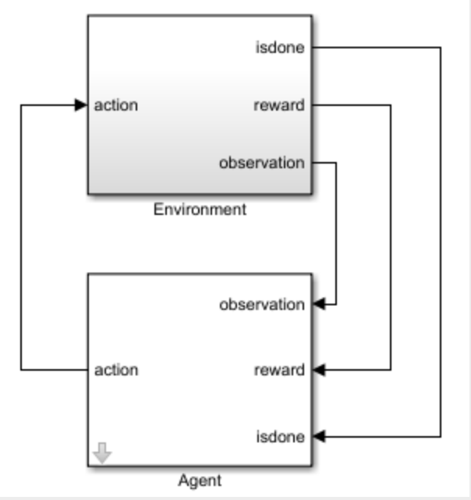





Reinforcement Learning Explained
Agent
Mathworks RL Toolbox
State
(current, speed)
Action
(control voltage)
Reward
Environment
(DC motor simulation)
Notes:
CIARAN
In reinforcement learning we create a structure in which to train our neural network:
In the RL context, We refer to our controller as an ‘Agent’ whose goal is to learn a ‘behaviour policy’ – it must choose the best ‘Action’ (which is output voltage) to perform in each state (where the state is defined by the motor speed and current feedback at that instant in time)
The motor model becomes our ‘Environment’ and the agent will interact with this
The agent will behave randomly at first to explore the effect of different actions, but will learn with experience to choose better actions
We feed back how ‘good’ actions were by defining a reward function
For example we may choose to give a positive reward for an action which makes the speed tracking error smaller or give a negative reward for an action which uses a high voltage and therefore lots of energy.
The ‘brains’ of the Agent is our neural network and the weights are updated in such a way as to learn a policy that maximises the reward
This may seem complex but it is really just another way of training a neural network. Instead of dealing with datasets, we treat controlling our motor as more like learning to play a game
There are many different types of RL algorithm and we spent much of our project time experimenting with and comparing different agents.
Fortunately MathWorks provides the RL Toolbox which supports many different types of agent and makes the reinforcement learning much easier to set up

Slide 6


Actor Critic RL
Agent
Actor
Policy
update
State
(current, speed)
Critic
Action
(control voltage)
Reward
Environment
(DC motor simulation)
Notes:
- When defining our Reinforcement Learning agent, we chose to focus on the so-called 'Actor-Critic' type of Reinforcement Learning algorithms.
- Given that both our action space and value function are continuous, using an Actor-Critic model with Neural Networks allows our agent to account for all these values.
- The Actor is the actual Neural Network which gets deployed, but during training there are one or more Neural Networks which in turn learn to train this Actor. These are called the Critics.

Slide 7
Our Experiments
Variations of Actor-Critic model:
TD3 (Twin Delayed Deep Deterministic Policy Gradient)
SAC (Soft-Actor-Critic)
PPO (Proximal-Policy-Optimizer)
Neural network architectures:
Fully Connected Layers
RNNs (Recurrent Neural Networks)
ReLU, LeakyReLU, Tanh Activation Funcs
Skriv text här
Notes:
- Three Actor-Critic model types we tried were TD3 (Twin Delayed Deep Deterministic Policy Gradient), SAC (Soft-Actor-Critic), and PPO (Proximal-Policy-Optimizer).
- Using these models, it was also tested how the inclusion of a style of RNN or (Recurrent-Neural-Network) called LSTM, which stands for (Long-Short-Term-Memory), in the Neural Networks would affect performance.
- In short, the RNN allows the network to store previous iterations for future ones, creating a sort-of memory, allowing the network to see both the velocity and momentum change of the signal.
- Models also included variants of ReLU, and Tanh. These are the activation functions which make the Neural Networks able to map non-linearities.
- One of the main goals here were to use as few Neurons as possible in our Fully Connected Layers, in order to save space on FPGAs, whilst still keeping enough complexity to be able to be accurate.
Here is old ***************************************************************************************
Actor-critic methods (a type of reinforcement learning) to train 2 networks.
The “Critic” estimates the value of possible next actions.
The “Actor” updates itself by taking the action suggested by the Critic.
Only the actor is implemented on the FPGA.
This limits the size of actor network
--------
Saw SS error in simple neural net. To overcome this, we added an integral element to the reward function to push the output closer to reference signal.
--------
Explored RNNs, which add memory to the system, to try and minimise overshoot

Slide 8
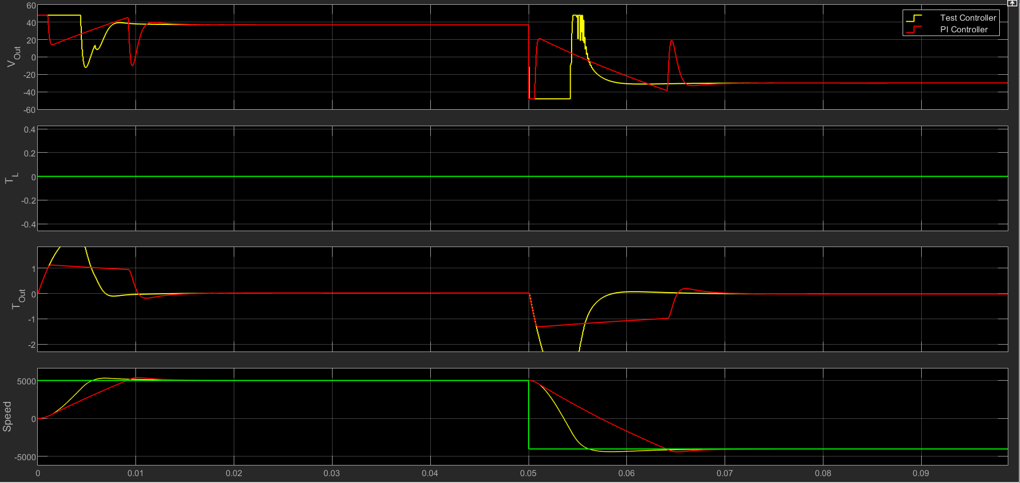
Best Testbench Result: TD3
Notes:
In order to train our models we use simulink to simulate the response of the DC motor control loop when trying to track a random sequence of reference speeds and load torques. The observations at each timestep are stored and used in the reinforcement learning algorithms in order to incrementally learn an optimal response. The training script saves the best network weights to be tested and deployed later.
We have made a tesbench to compare the controller response to the PI controller
This is a screenshot of our best performing controller using the TD3 architecture when using the testbench.

Slide 9
FPGA Deployment
Convert to basic mathematical function blocks
Convert to fixed point
HDL coder
Notes:
In order to actually deploy the controller to an FPGA, it must be converted to a Hardware Description Language.
MATLAB's HDL Coder tool provides a simple means of performing this conversion.
Before this conversion can be completed however, a couple of steps must be taken:
The RL Agent block should be removed and replaced by a simple custom implementation of the Actor network using simple Simulink maths blocks
The default double-precision floating-point units used by the model should be converted to fixed-point units of appropriate accuracy using the fixed-point tool.
Finally the HDL coder can be used to produce something that be loaded onto an FPGA.

Slide 10
Video Demonstration
Notes:
-- Someone add notes please --
As we've seen, our work has mainly revolved around the studying and testing of different machine learning methods for this motor control problem.
We believe that this work has shed a lot of light on the future possibilities in implementing motor control using Reinforcement Learning, and has created some clarity which the team at Intel can now
'spring-board' off.
We have found many avenues that could be further explored that we believe have potential to improve on the speed, efficiency and utility of motor controllers.
Before we go on the Q&A, we have also prepared a 7-minute video we'd like you to see. It will go through the processes we've used, and a few key points about our model and its implementation.

Slide 11
Q&A
Notes:
-- Someone add notes please --
As we've seen, our work has mainly revolved around the studying and testing of different machine learning methods for this motor control problem.
We believe that this work has shed a lot of light on the future possibilities in implementing motor control using Reinforcement Learning, and has created some clarity which the team at Intel can now
'spring-board' off.
Before we go on the Q&A, we have also prepared a 7-minute video we'd like you to see. It will go through the processes we've used, and a few key points about our model and its implementation.

Slide 12
Q&A Section: Next Steps
RNNs (LSTM units)
Stochastic Agents (SAC, PPO)
Online fine-tuning
Test and optimize on hardware (HDL Verifier, Quartus)
Larger Networks
More Detailed Model (SimScape Electrical)
3-Phase Motor
Multi-Motor Control
Increasing clock speed
Notes:
We believe there are still a lot of further steps that could be investigated with potential to improve on the speed, efficiency and utility of motor controllers.
As the agent interacts with a system that involves delays and inertia, the introduction of recurrent neural networks should allow for a system memory. Our early LSTM tests suggested an improved steady state error, but longer training times and more hyperparameter choices meant that we did not find a better solution involving RNNs.
The non-deterministic aspect of training SAC and PPO agents is known to improve the exploration of the agent during training and in our experience we have found these agents more successful at escaping local minima.
On-line agents like PPO were found to take longer to converge to a good solution but potentially allow for the network weights to be fine-tuned while the controller is running on the FPGA.
Test and optimize for hardware:
Models had larger energy losses, other agents/reward functions can minimise
We have found that increasing the network size resulted in a longer convergence time so we focussed on finding hyperparameters for a smaller network, but the added neurons would allow for the network to approximate more complex non linear functions in order to solve tougher optimization problems involving factors such as the reducing the energy consumption of the motor.
A larger network may also be needed when applying this solution to more realistic simulation models and the more complex 3-phase motor which is commonly used in industry.
Once the size of the networks has been investigated against the hardware limits of FPGA there is potential for multiple controllers to be deployed on the same FPGA, allowing for Multi-axis control.
(not sure about this last bit)
Additionally our early tests have found the networks can be trained to achieve similar performance when simply outputting a positive or negative maximum voltage. This actor could then be deployed on the FPGA and run at a higher clock frequency as it eliminates the need for the slower PWM, allowing for even faster control.

Slide 13
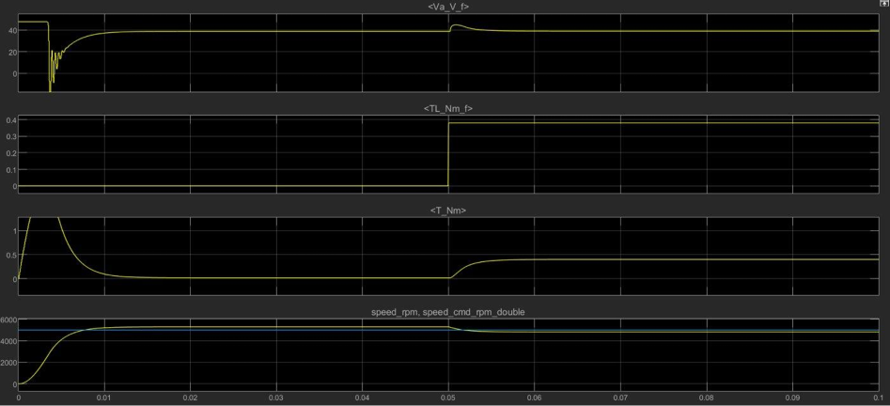
Q&A Section: Naïve solution 3x2x3x1
Notes:
This is the response of a simple three layer neural network with randomly assigned weights.
The network has a faster response time than the PI controller, but has a larger steady state error.
It has also overfit to this scenario and has bad performance when given randomised commands.

Slide 14
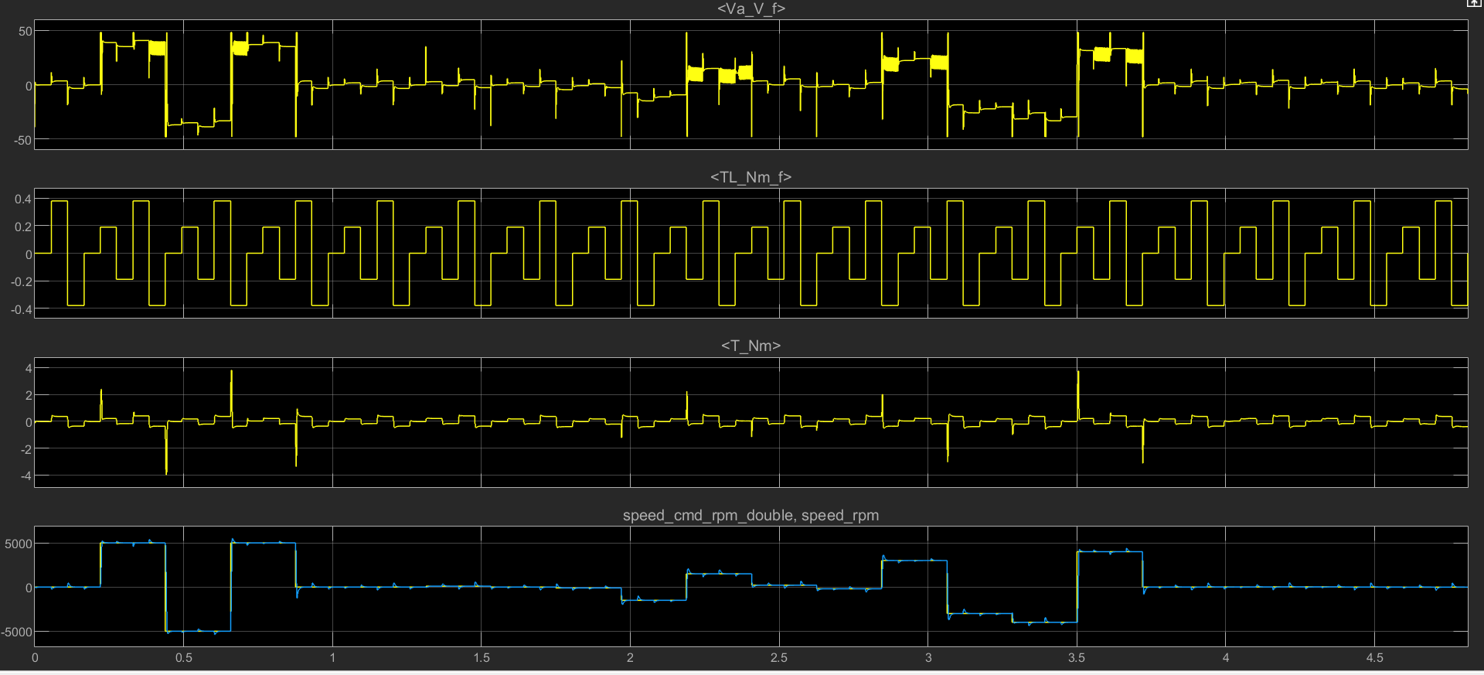
Q&A Section: TD3 Speed control Simple NN 4x2x1
Notes:
+ves:
Simple Architecture
approx. 40% error reduction from PI control
Faster rise time
-ves:
Some overshoot
high frequency voltage signal
30% increase in energy loss

Slide 15
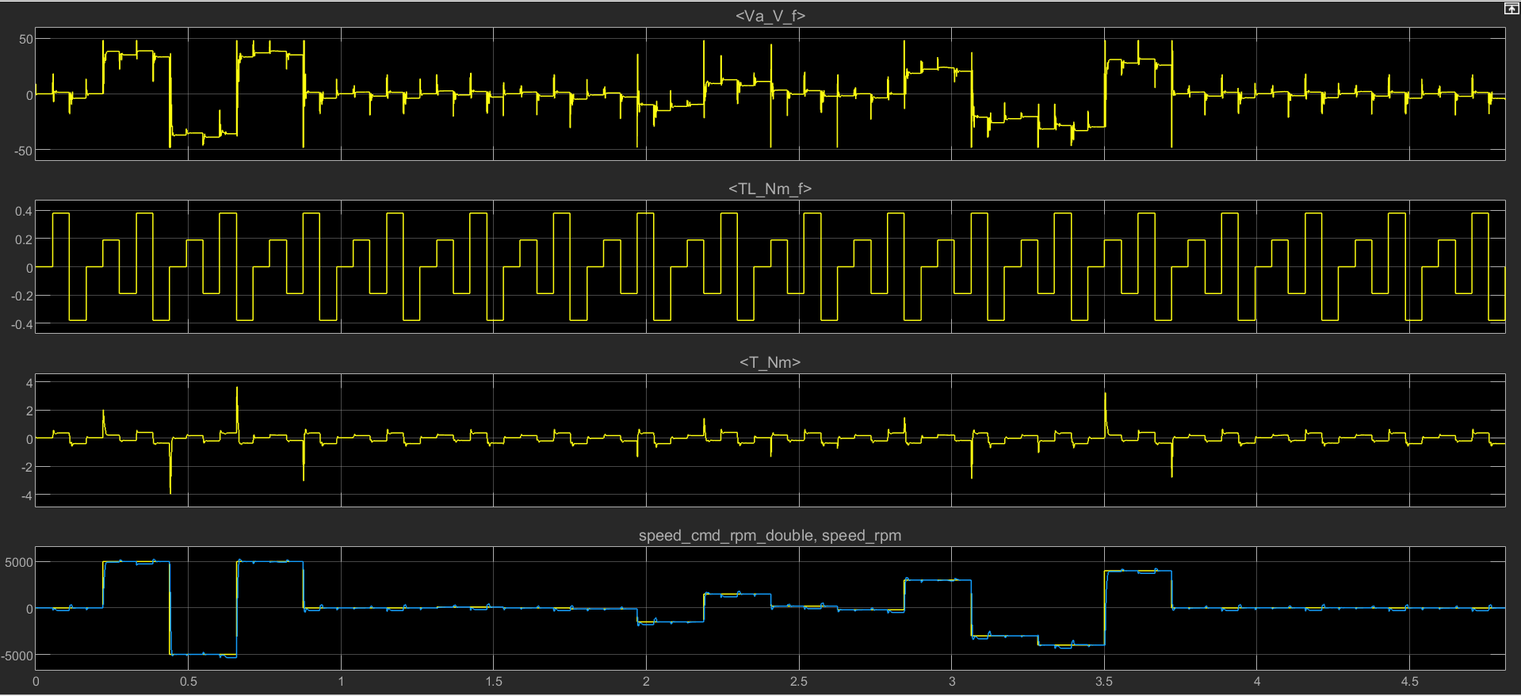
Q&A Section: SAC Speed control Simple NN 6x3x1
Notes:
+ves:
Simple architecture
approx. 30% error reduction from PI control
Good SS
-ves:
approx. 16% energy loss increase from PI control
Some torques have SS error

Slide 16
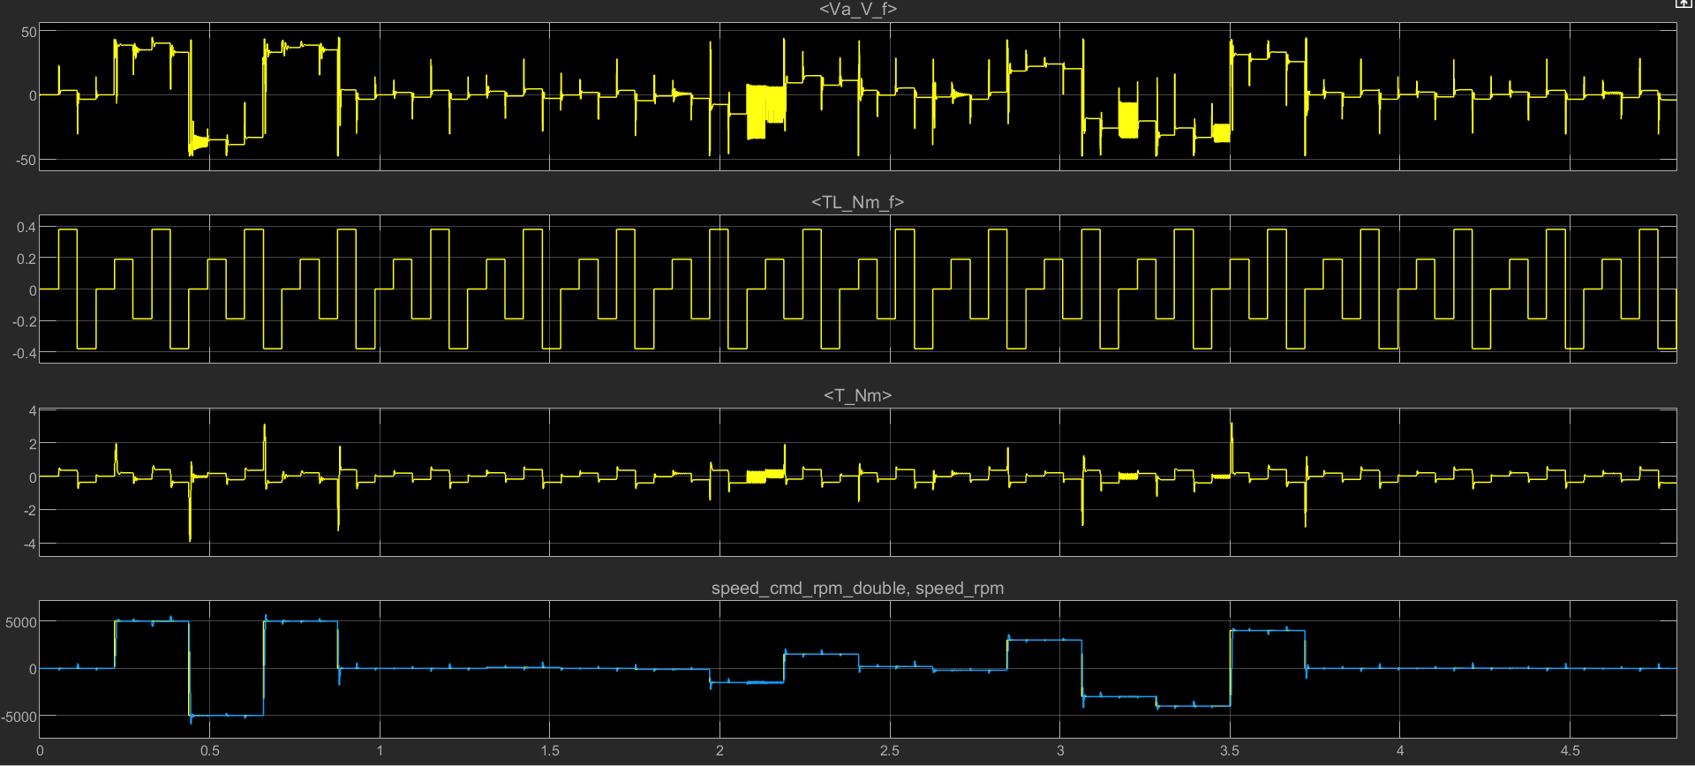
Q&A Section: PPO Speed Control RNN 32x32x1x (LSTM: 16) x32x1
Notes:
+ves:
30% error reduction
Good SS
-ves:
Complex architecture
37% energy loss increase

Slide 17
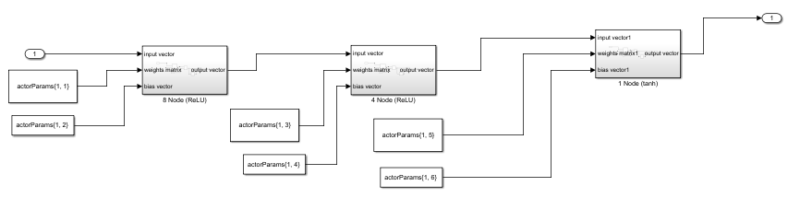
Q&A Section: Block level implementation
Notes:
Simple implementation of 3 layer actor network

